Slide 1
The Other Gates
XOR and XNOR

Slide 2
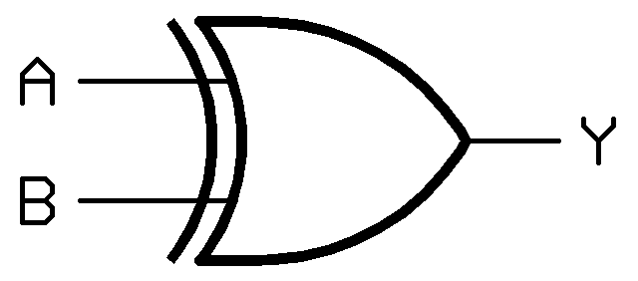
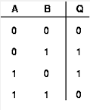

XOR (Exclusive OR)
A ^ B
A B
A [+] B
gate symbol
A B

Slide 3

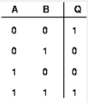

XNOR (Exclusively NOT OR or NOT XOR)
(A B )’
(A [+] B)’
gate symbol
A B

Slide 4
Complete Worksheet
Copy and paste the questions and your answers into the text box on the HUB. Do not attach the file.
Make sure your answers are formatted correctly after you paste.

